Slide 1

IoT Enabled e-Farming And Monitoring System
PG-Diploma in Internet of Things

Slide 2
Team Members
Aniket Rajigare
Nandan A
Ritesh Nagare
Shreyash Sarage
Siddhesh Nandurkar

Slide 3
Introduction
The Internet of Things (IoT) is a rapidly growing technology that is transforming various industries, including agriculture. IoT-enabled e-farming and monitoring systems are smart farming solutions that leverage IoT technology to automate and optimize farming operations.
These systems consist of sensors, gateways, and database that enable real-time monitoring and control of various environmental parameters, such as temperature, humidity and soil moisture.
Terrace farming is a traditional farming practice that has been used for centuries in hilly and mountainous regions to maximize the use of limited arable land. IoT-enabled e-farming and monitoring systems can helps by providing real-time monitoring and control of various environmental parameters, such as soil moisture and temperature.

Slide 4
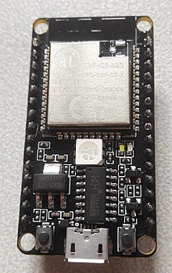
ESP32 Sensor
ESP32 is a series of low-cost, low-power system on a chip microcontrollers with integrated Wi-Fi and dual-mode Bluetooth.
ESP32 is a single 2.4 GHz Wi-Fi-and-Bluetooth combo chip designed with the TSMC low-power
40 nm technology.

Slide 5
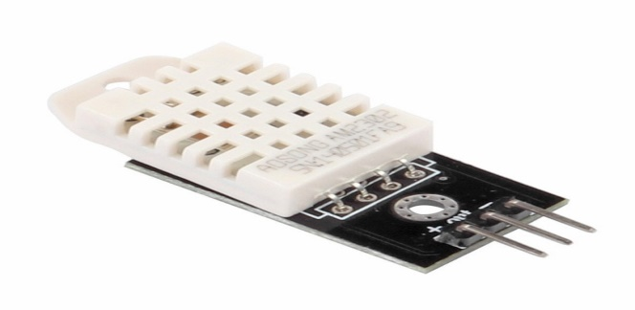
DHT22
DHT22 output calibrated digital signal. It utilizes exclusive digital-signal-collecting-technique and humidity sensing technology, assuring its reliability and stability. Its sensing elements is connected with 8-bit single-chip computer.

Slide 6
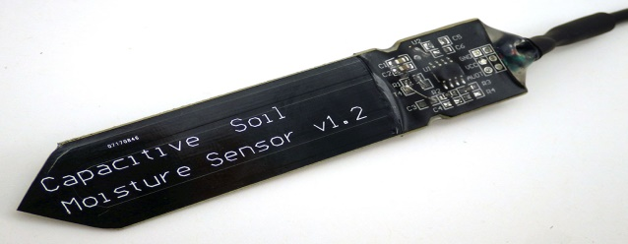
Capacitive Soil Moisture Sensor
This Capacitive soil moisture sensor measures soil moisture levels by capacitive sensing rather than resistive sensing like other sensors on the market. It is made of corrosion-resistant material which gives it excellent service life.

Slide 7
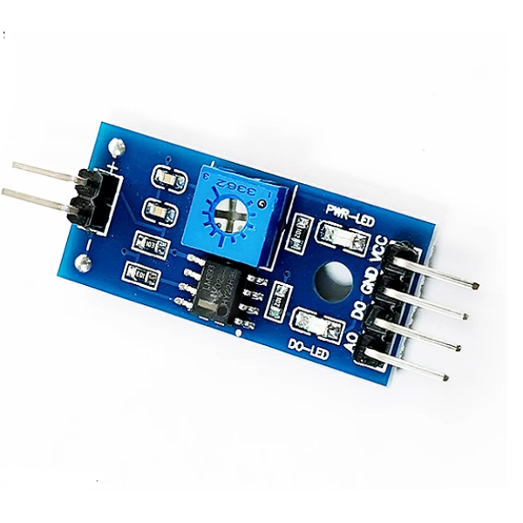
Analog to Digital Converter
A converter that is used to change the analog signal to digital is known as an analog to digital converter or ADC converter.

Slide 8
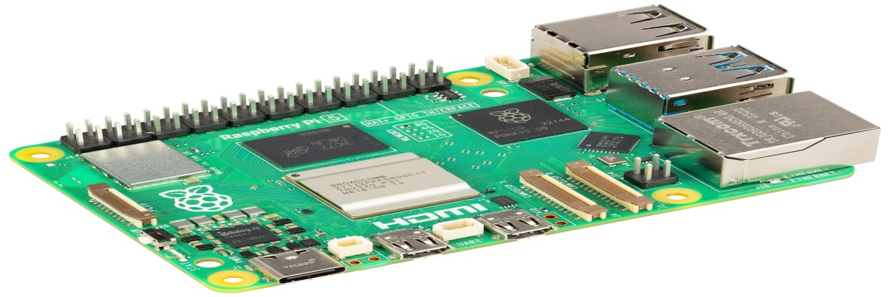
Raspberry Pi
The Raspberry Pi is a debit card-sized low-cost computer that connects to a computer Desktop or TV and uses a standard mouse and Keyboard. It has a dedicated processor, Memory and a graphics driver, just like a PC. It also comes with its operating system, Raspberry Pi OS, a modified version of Linux.

Slide 9
Application’s
Visualisation: An IoT-enabled e-farming and monitoring system can enable remote monitoring and control of various farming operations, allowing farmers to manage their farms from anywhere, at any time.
Improved operational efficiency: An IoT-enabled e-farming and monitoring system can help improve operational efficiency by automating various farming operations, reducing the need for manual labor, and providing real-time data for decision-making.
Real-time monitoring of environmental parameters: An IoT-enabled e-farming and monitoring system can provide real-time monitoring of environmental parameters, such as soil moisture, temperature and humidity to help farmers make informed decisions about irrigation and other farming operations.
Optimization of resource usage: By using sensors to monitor environmental parameters and crop growth, an IoT-enabled e-farming and monitoring system can help optimize the use of resources, such as water and energy, leading to cost savings and a reduced environmental impact.

Slide 10
Advantages
Durability.
Reliability.
Cost Efficiency.
Energy Efficiency.
Ability to Process & Compute Real-time Data.

Slide 11
Conclusion
In conclusion, the IoT Enabled E-Farming and Monitoring System stands at the intersection of cutting-edge technologies and agricultural practices, promising transformative benefits for farmers. By seamlessly integrating sensors, communication protocols, the system enables real-time data collection, analysis, and remote control, empowering farmers with actionable insights and efficient resource management. As we advance in hardware, software, and user interface design, ensuring security, scalability, and sustainability remains pivotal. Collaborative efforts, user training, and continuous innovation will play key roles in realizing the full potential of the technology, ultimately fostering a more resilient and productive future for agricultural.

Slide 12
Thank You
Regards Team
IoT Enabled e-Farming And Monitoring System.
C-DAC, ACT’S (Pune)
“If you think that the internet has changed your life, think again. The Internet of Things is about to change it all over again!” — Brendan O’Brien

Slide 13

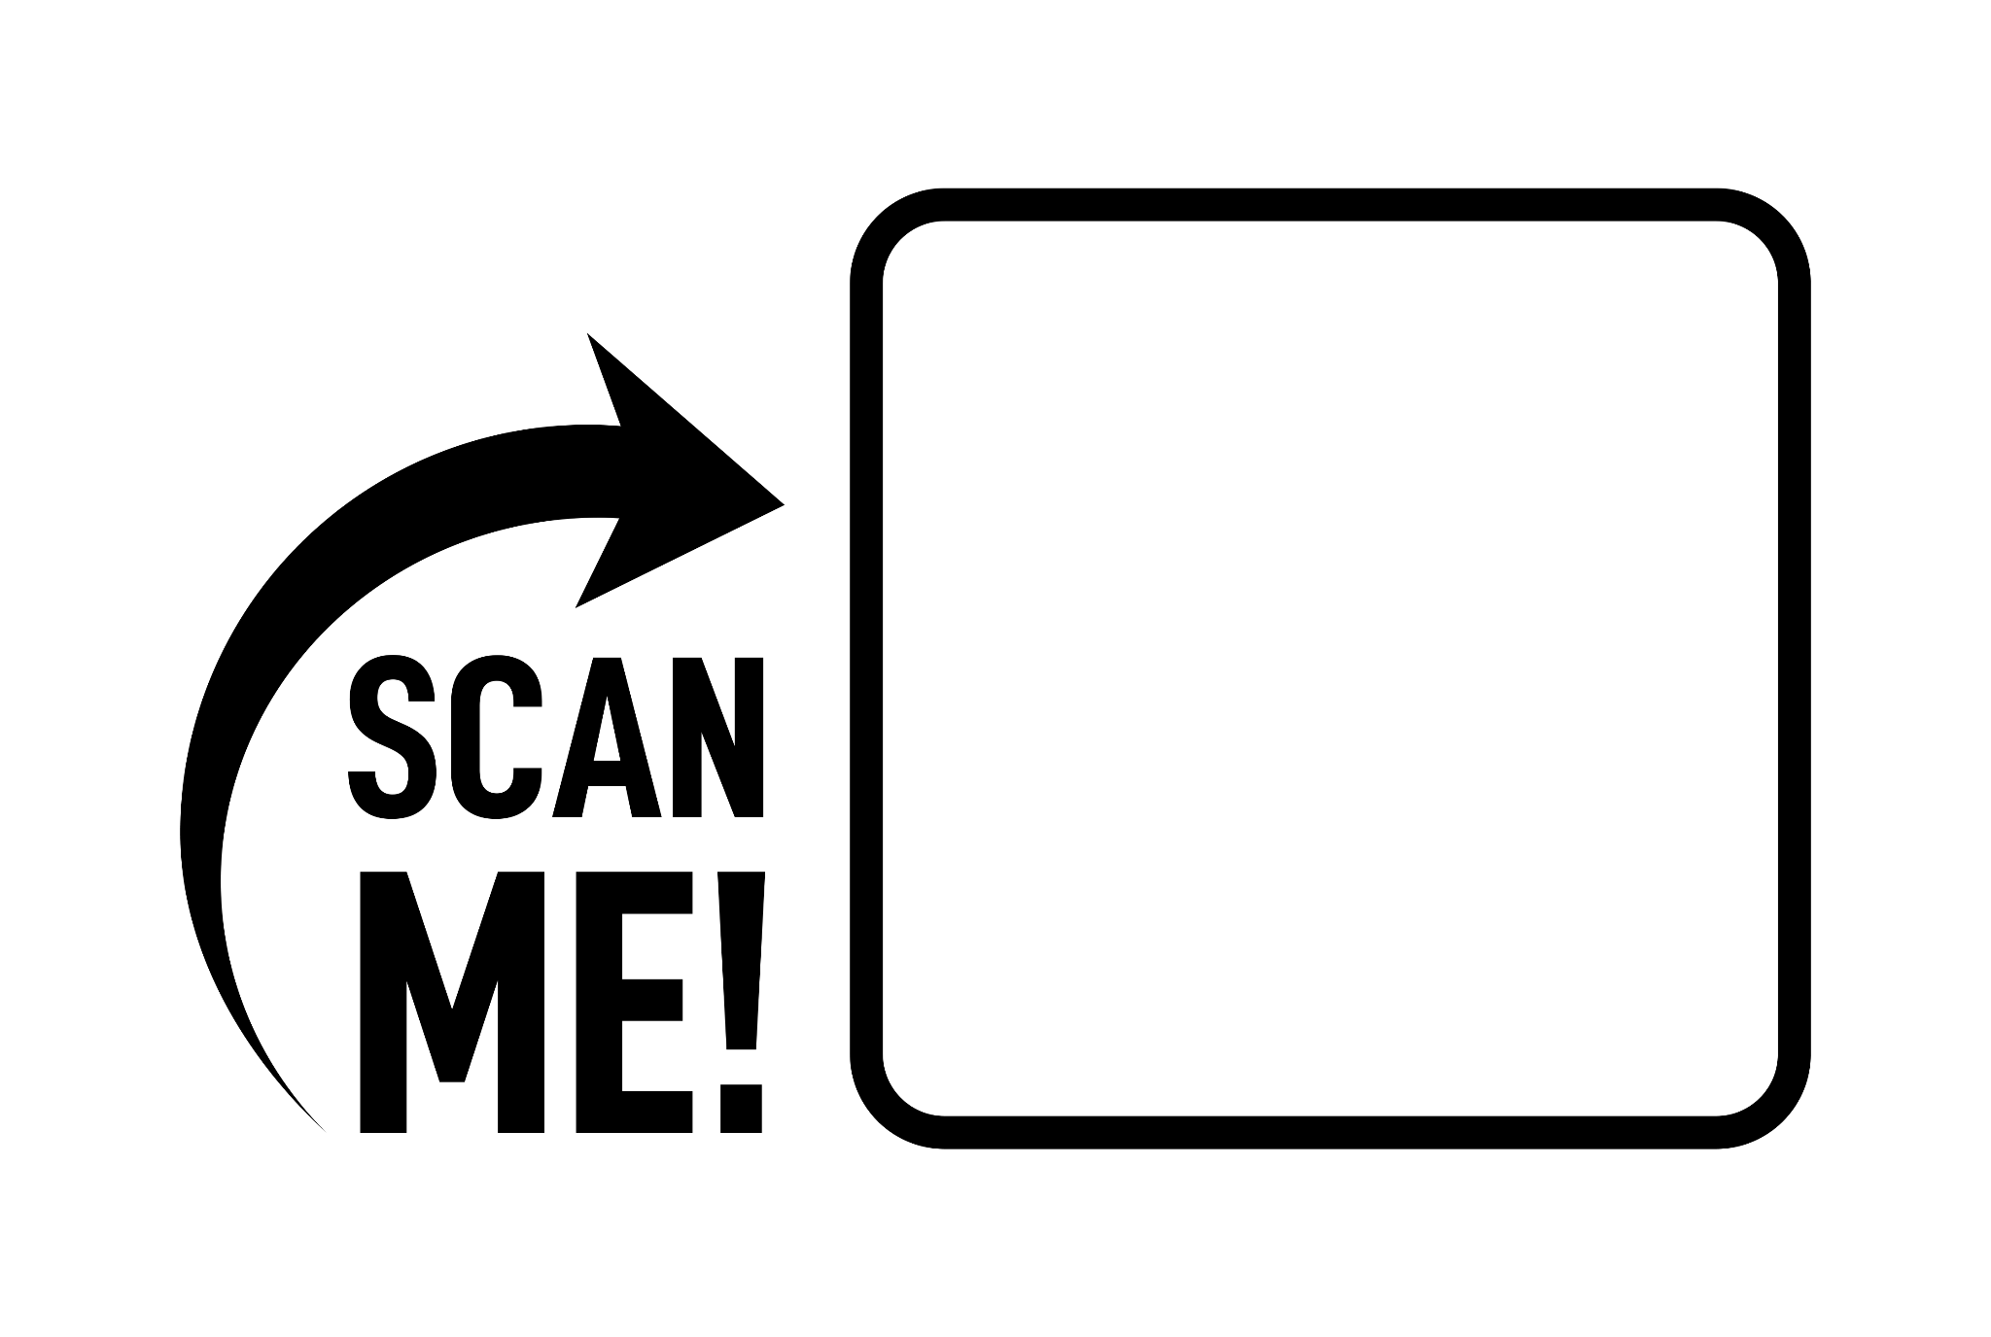
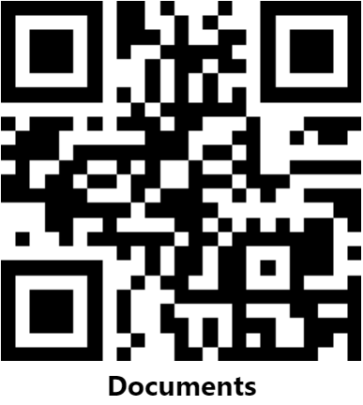
Visit us for more info

